Slide 1
COVID-19 in New York neighbourhoods – Nearby venues and positivity rate
Capstone Project for Coursera
Alok Gupta
November 30, 200

Slide 2
Introduction

Slide 3
Background
COVID-19 is caused by a coronavirus called SARS-CoV-2.
What are common features which aid or prohibit spread of the virus?
Data analysis can help to understand if neighbourhoods where the virus has been spreading at a fast rate, have venues or locations which are affecting the spread.

Slide 4
Problem
Relate venues (or their categories) in various New York neighbourhoods with COVID-19 percent positivity rate during November 15-21, 2020.
Do neighbourhoods with certain categories of venues show high or low COVID-19 percent positivity rate?
Is COVID-19 percent positivity rate independent of types of venues in a neighbourhood?

Slide 5
Stakeholders
The information can be used by
Local authorities to implement stricter measures for controlling the spread of infection in high positivity rate venues.
Neighbourhood residents to avoid visits or take more precaution while visiting common high positivity rate venues.

Slide 6
Data Sources & Data Cleaning

Slide 7
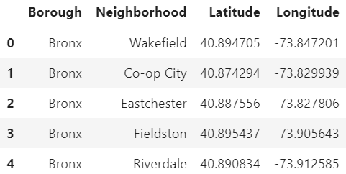
New York boroughs and neighbourhoods
Source: https://geo.nyu.edu/catalog/nyu_2451_34572

Slide 8
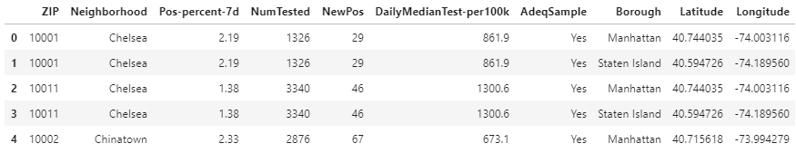
COVID-19 test data
Source: https://www1.nyc.gov/site/doh/covid/covid-19-data.page#epicurve

Slide 9
Exploratory data analysis

Slide 10
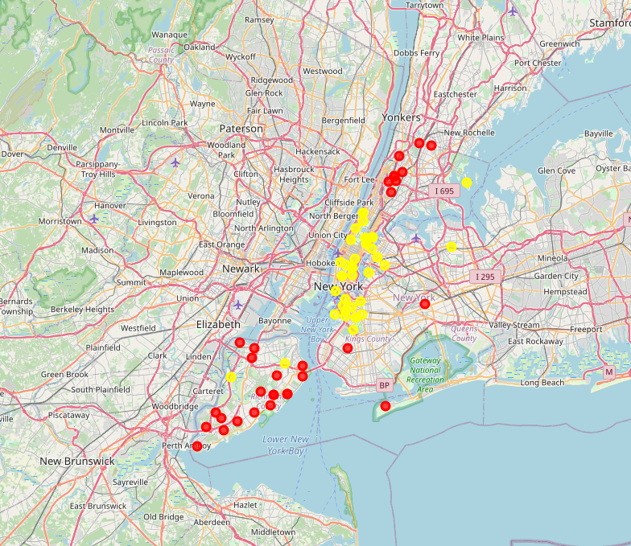

Neighbourhoods with high and low positivity rates

Slide 11
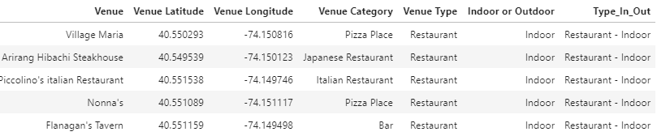
Venue category

Slide 12
Comparison of venues near neighbourhoods

Slide 13
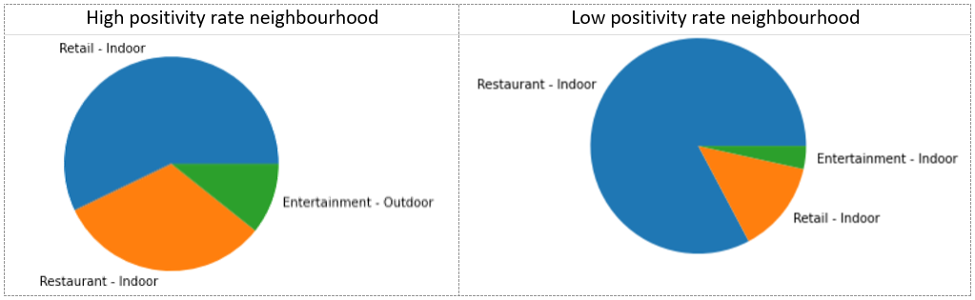
First most common venue

Slide 14
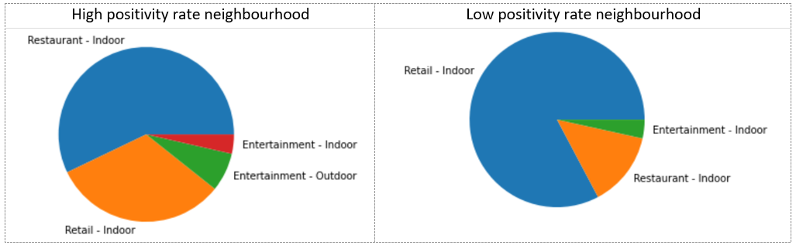
Second most common venue

Slide 15
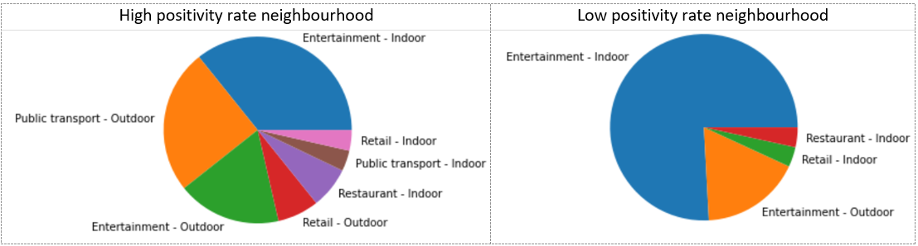
Third most common venue

Slide 16
K-means clustering of venues near neighbourhoods

Slide 17
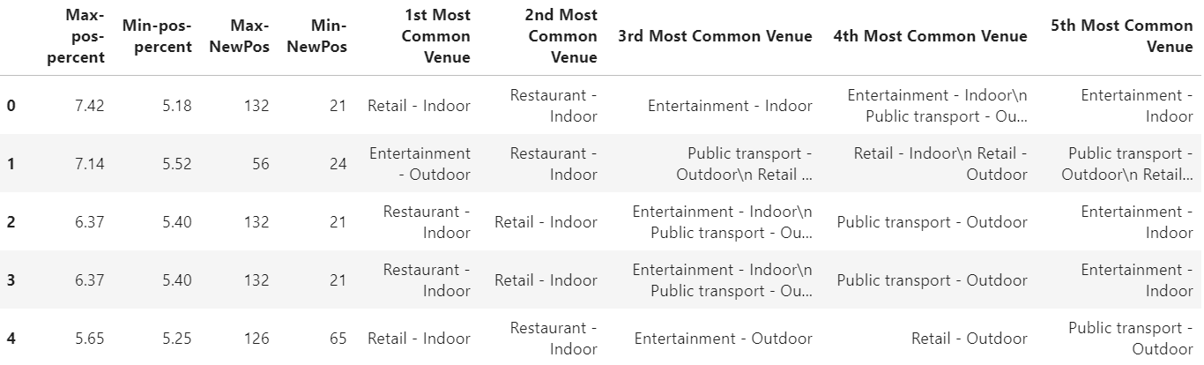
High positivity rate venue clusters

Slide 18
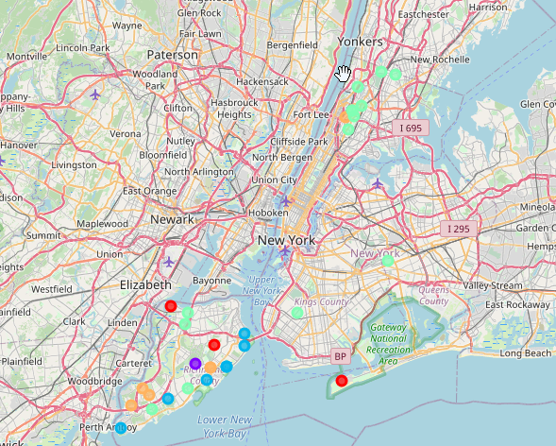
High positivity rate venue clusters

Slide 19
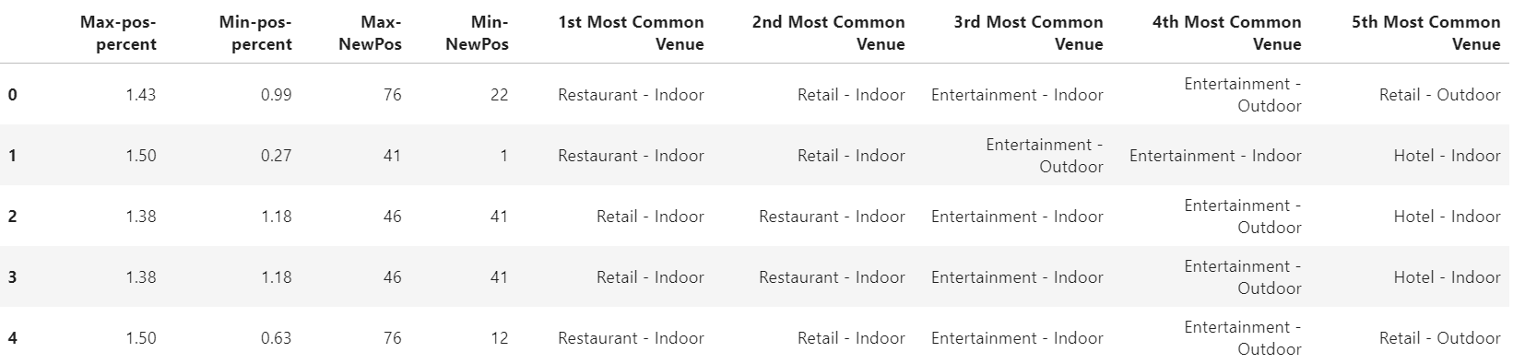
Low positivity rate venue clusters

Slide 20
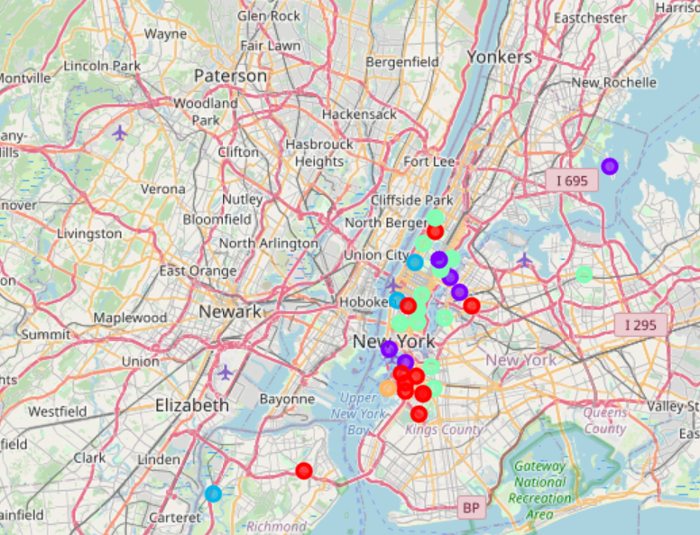
Low positivity rate venue clusters

Slide 21
Conclusion

Slide 22
Conclusion
Northern and southern neighbourhoods have a greater spread of COVID-19 compared to central neighbourhoods, in New York.
Majority of first and second most common venues – retail stores or restaurants.
High positivity rate neighbourhoods have abundance public transport venues. Public transport facilitates → more mobility → high positivity rate.
Public transport venues were part of all 5 high positivity rate venues.
The third most common venues in high positivity rate neighbourhoods → public transport venue for some clusters.
In low positivity rate clusters, the third and fourth most common venues are Entertainment venues.

